Slide 1
Multiple Pages Responsive College Website
Made By:- Dhruv Gupta

Slide 2
Features
When a cursor is placed on visit us to know more the block turns red and text turns white making
When the image is clicked on any of the pages it takes us back to home page
Website works in phones as well JavaScript is used to make the menu appear when clicked on the icon
Whenever a cursor is places above any course a shadow appears behind the block making is more visually appealing
When we hover over any of the campus the image becomes red and name of the campus is displayed in the center
When Contact Us is clicked we are takes to another html page Contact.html

Slide 3
Features
In Contact Us Page Google Maps location of the college is embedded
Further a form is created for visitors to contact us
This form is connect to php file which help us mail the form filled by the visitor to us

Slide 4
Languages Used
HTLM
CSS
JAVASCRIPT
PHP

Slide 5
HOME PAGE

Slide 6
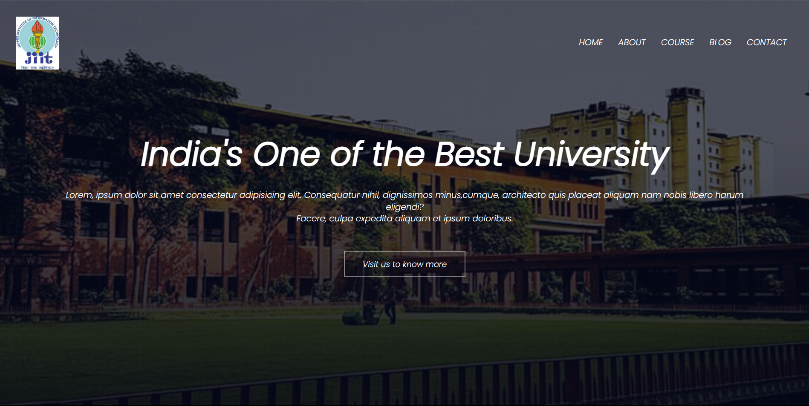

Slide 7
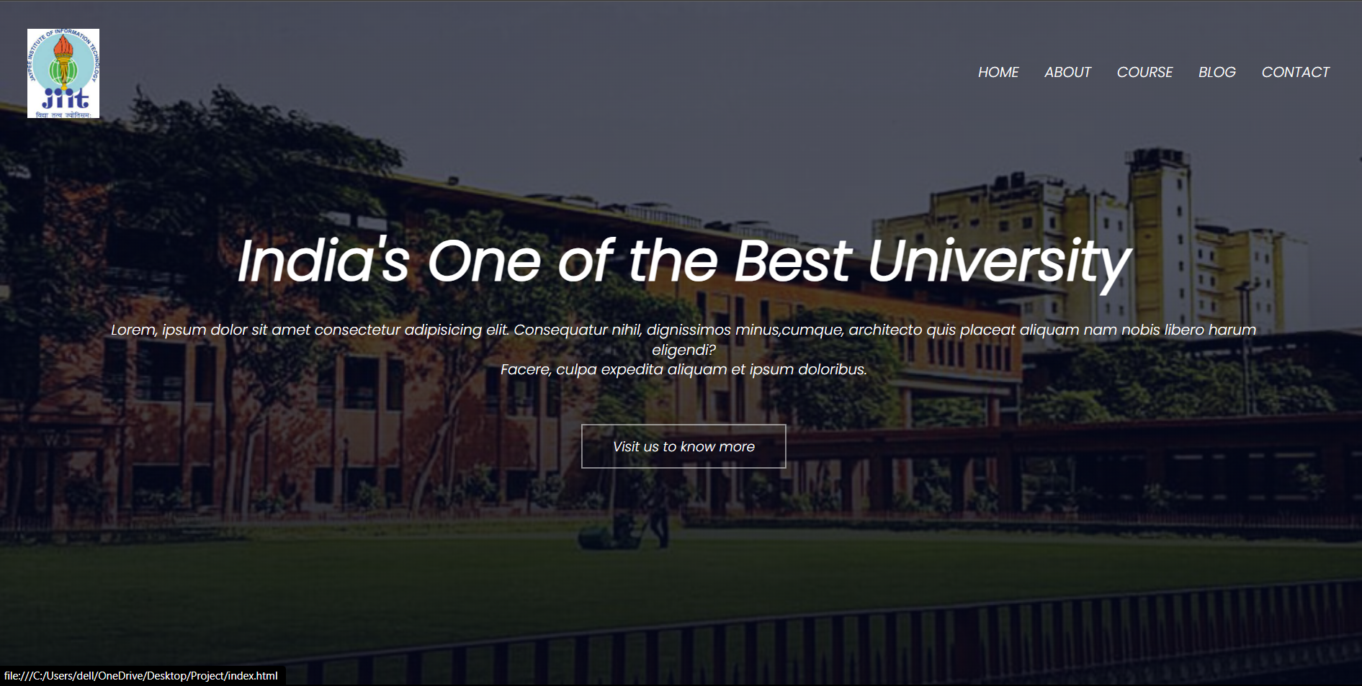

Slide 8
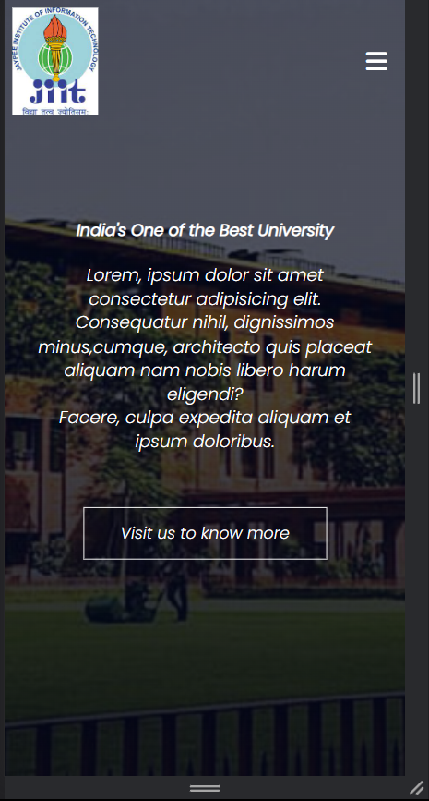
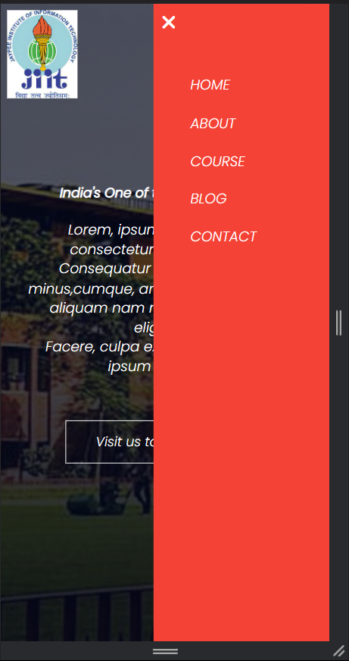

Slide 9
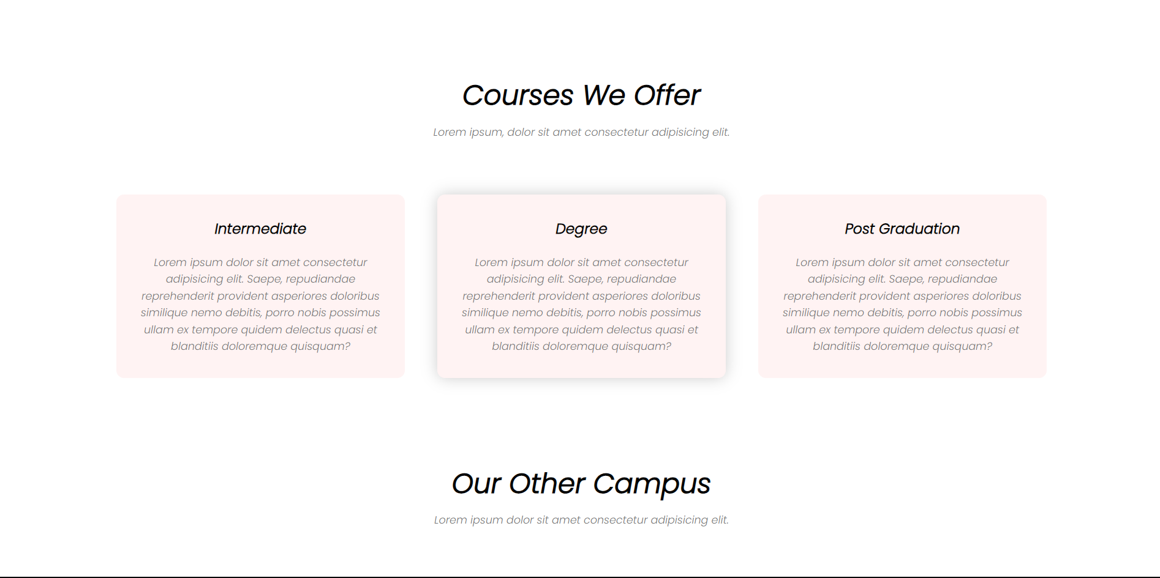

Slide 10
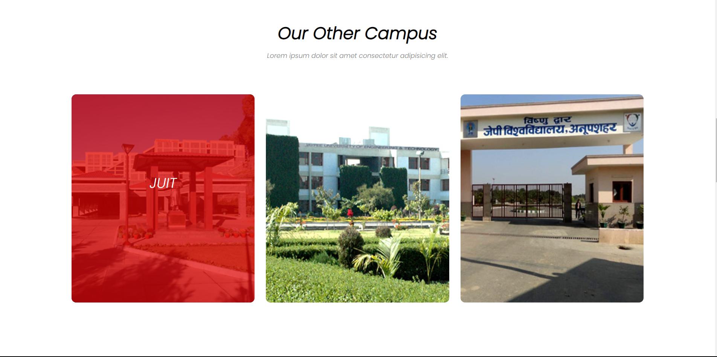

Slide 11
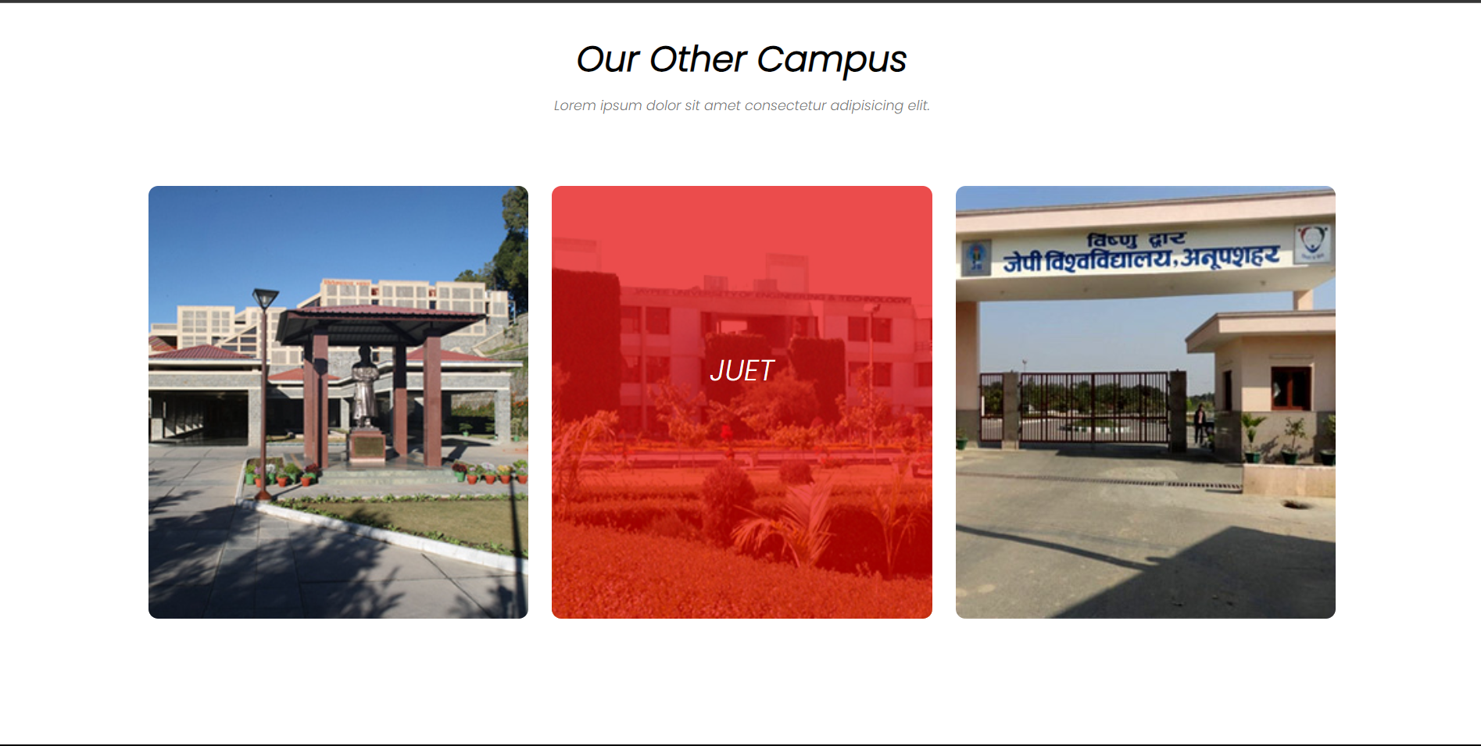

Slide 12
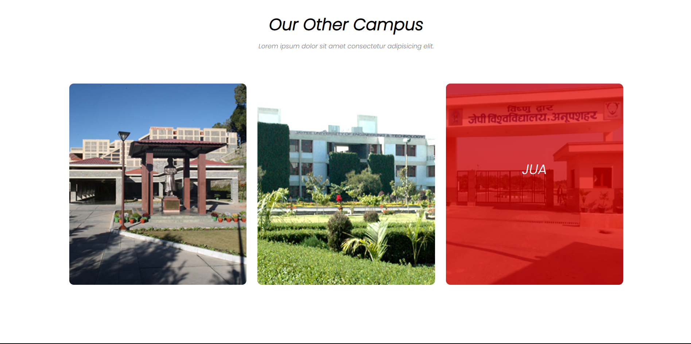

Slide 13
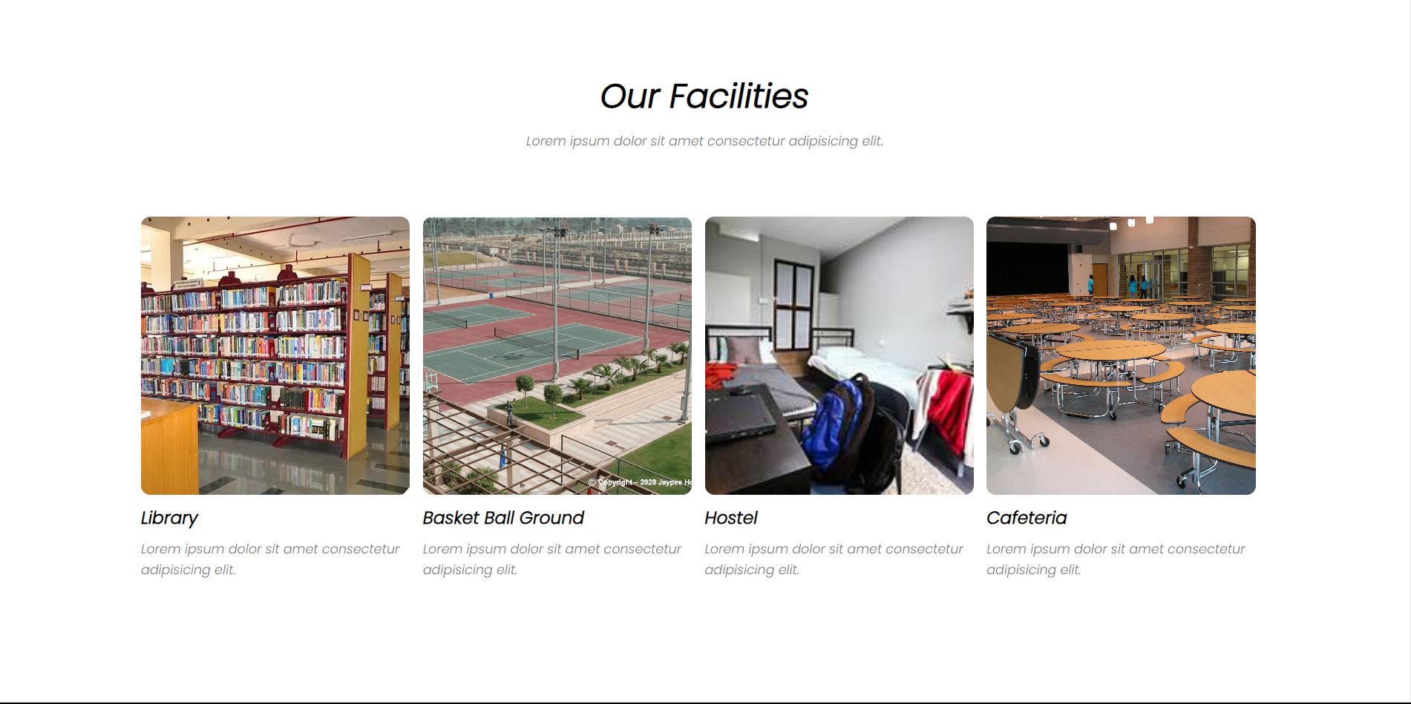

Slide 14
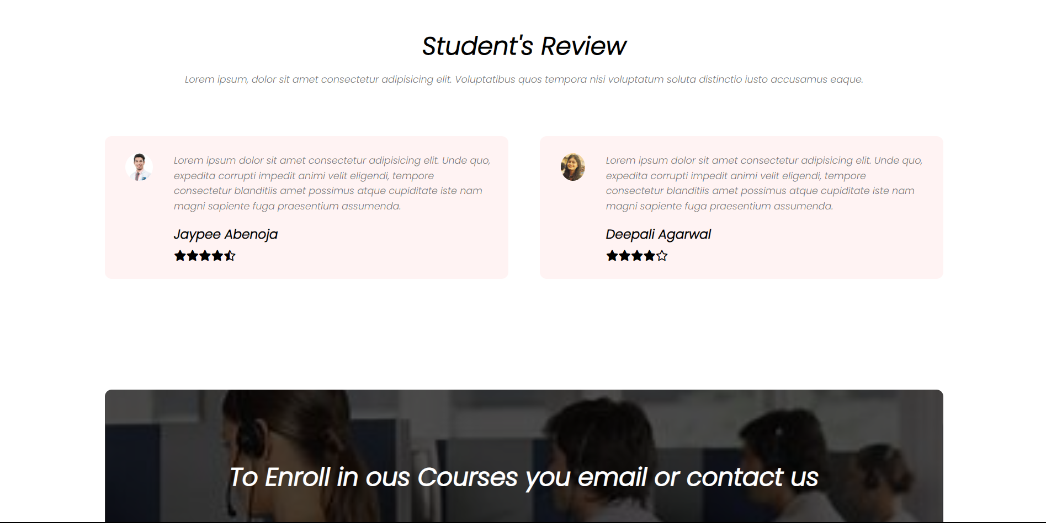

Slide 15


Slide 16
ABOUT PAGE

Slide 17


Slide 18
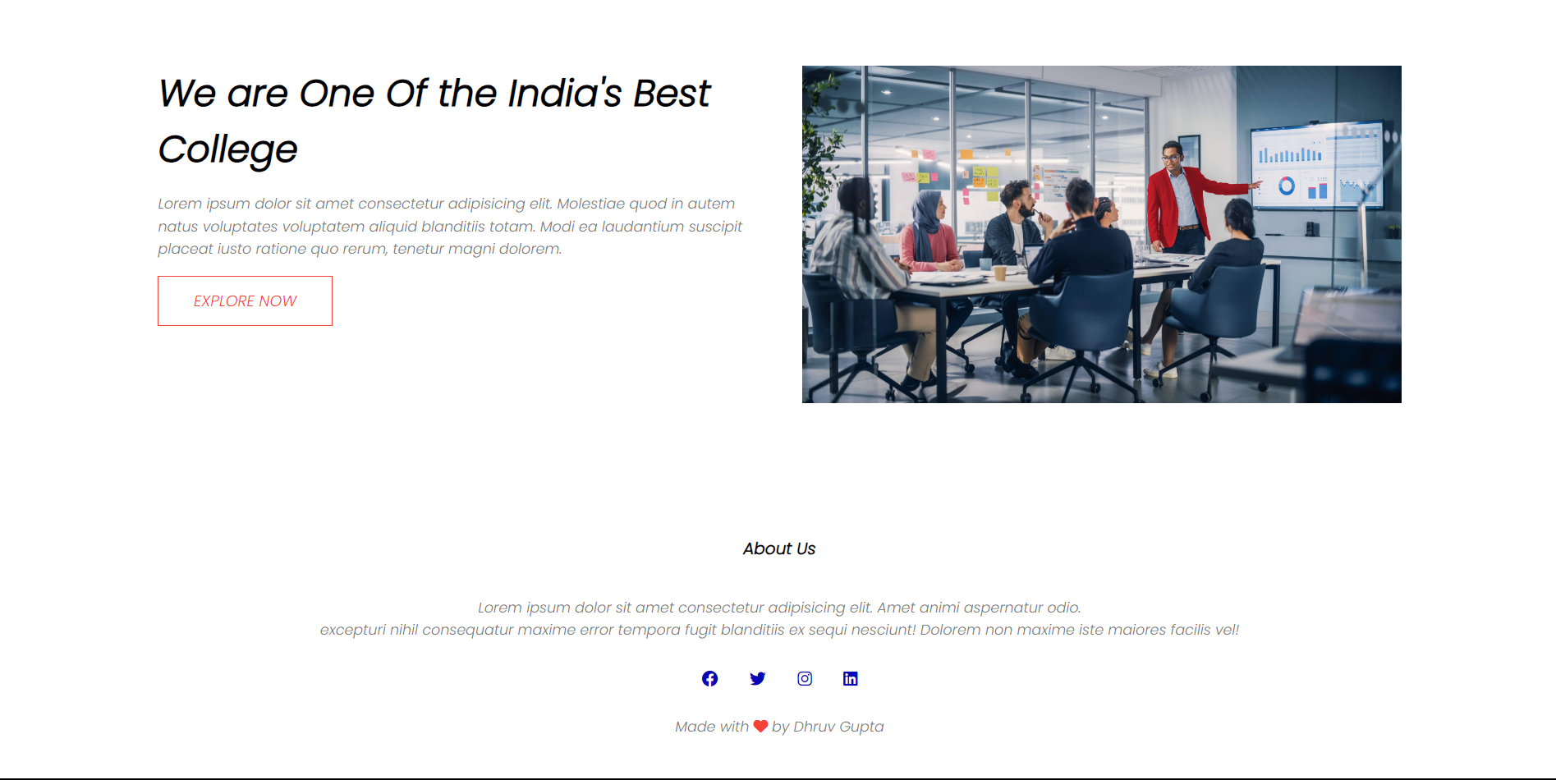

Slide 19
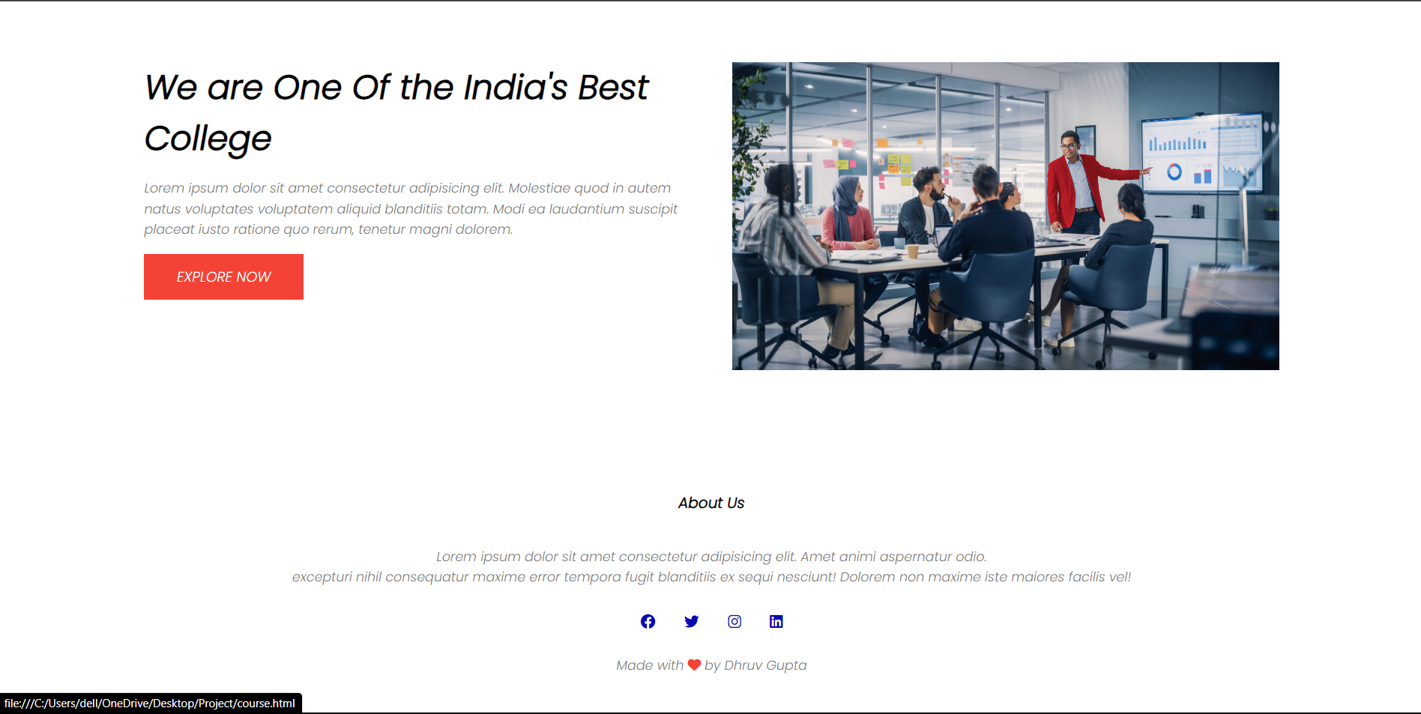

Slide 20
COURSES PAGE

Slide 21
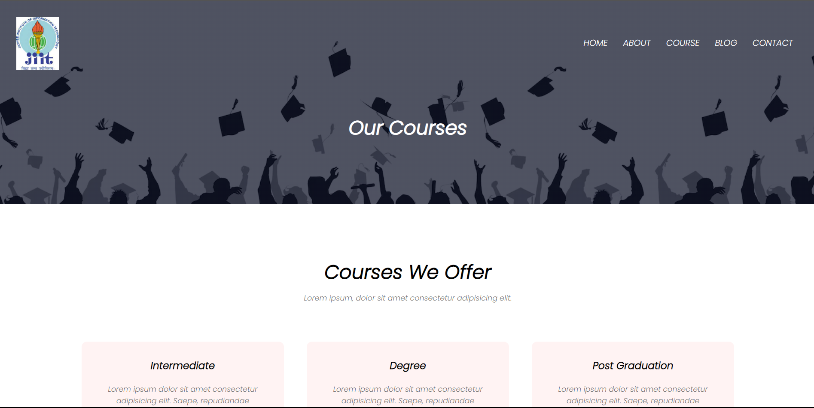

Slide 22
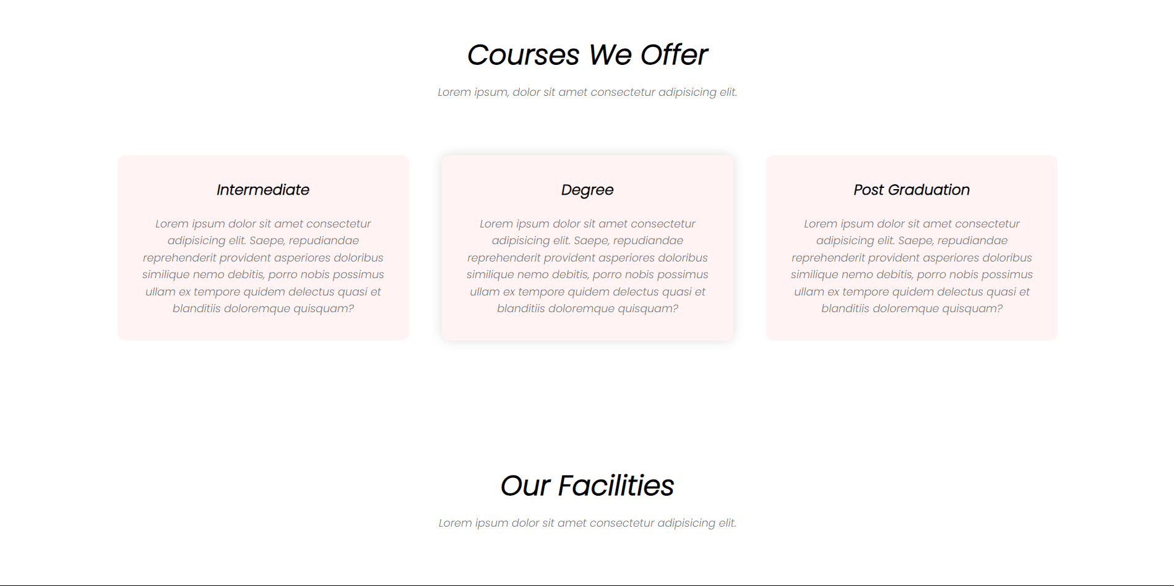

Slide 23
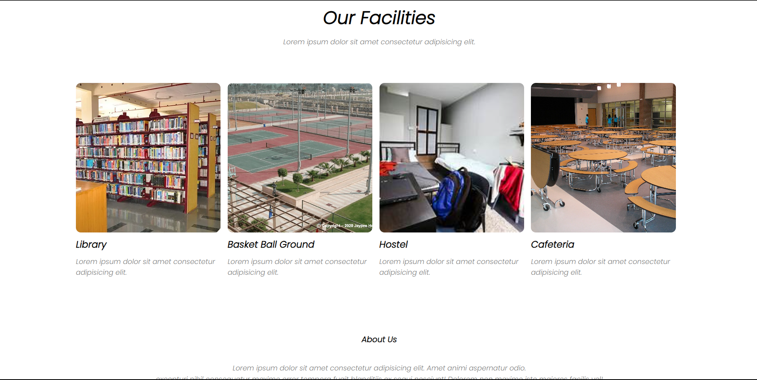

Slide 24
BLOG PAGE

Slide 25


Slide 26
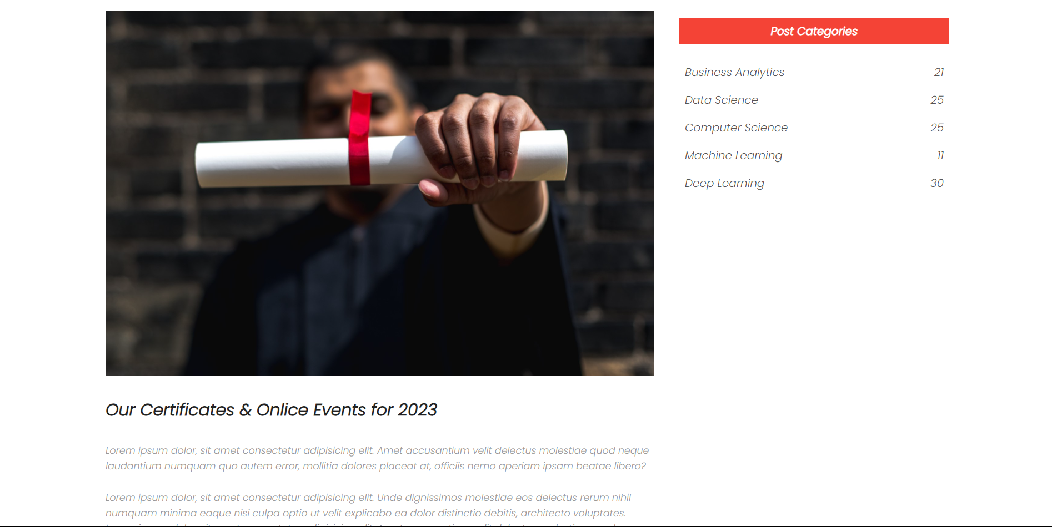

Slide 27
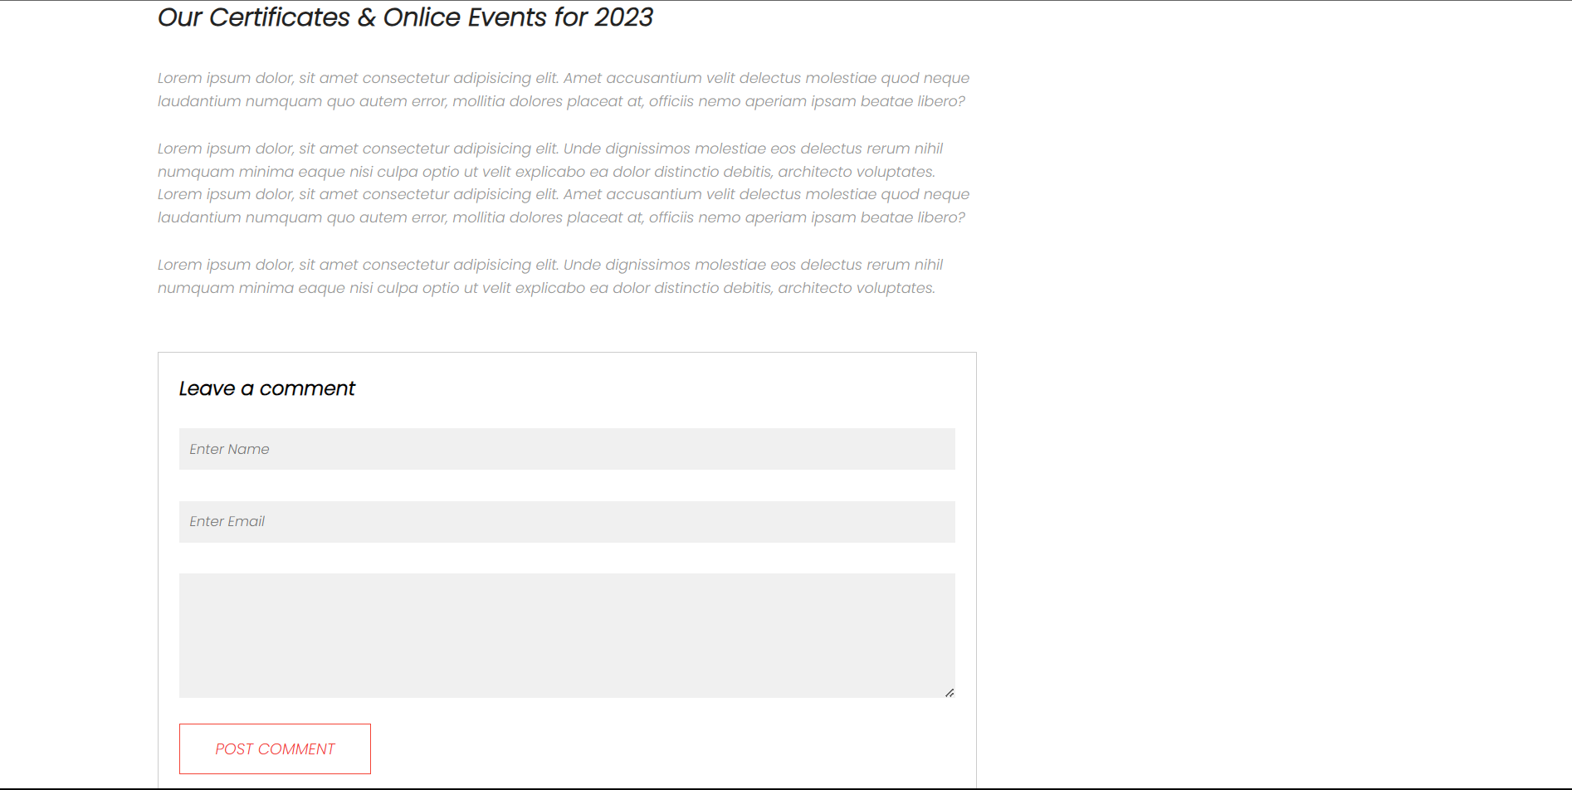

Slide 28
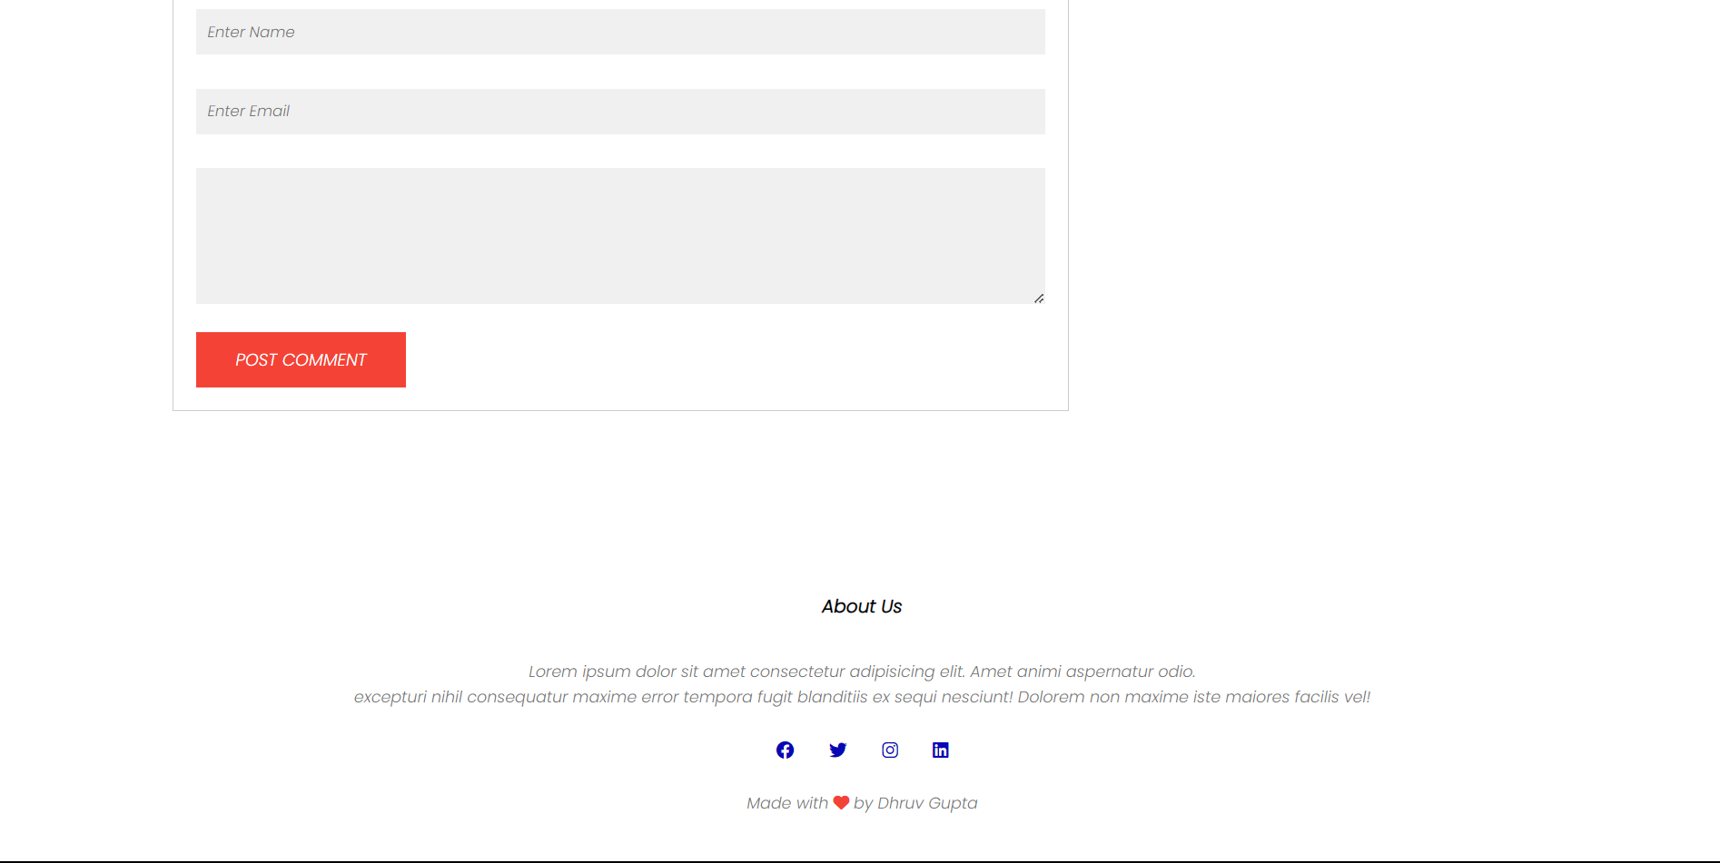

Slide 29
CONTACT PAGE

Slide 30
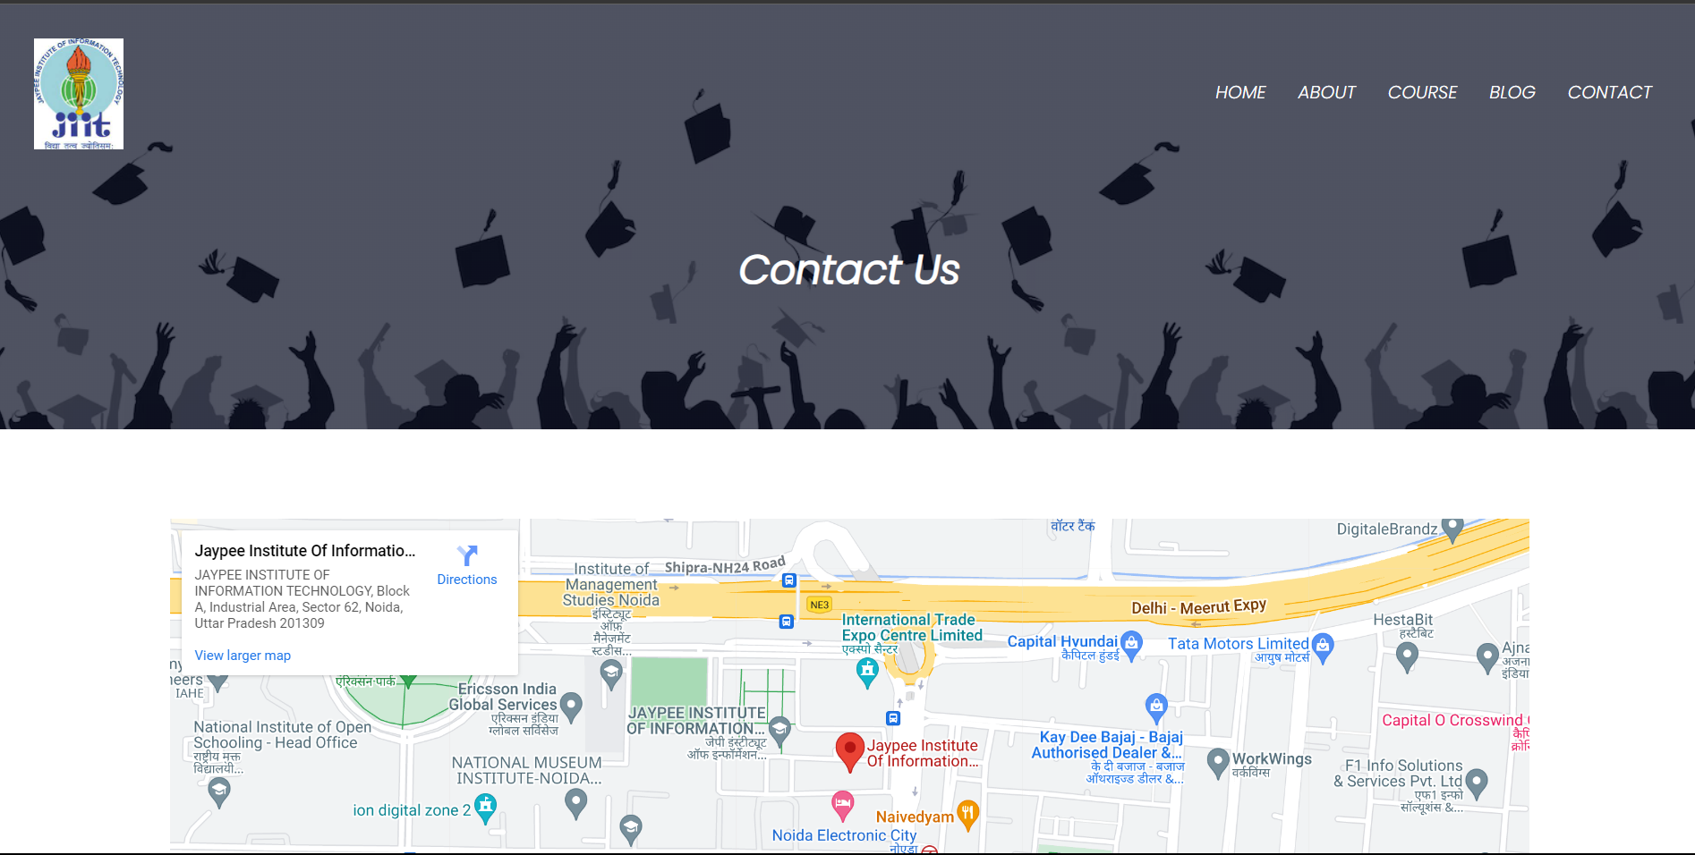

Slide 31
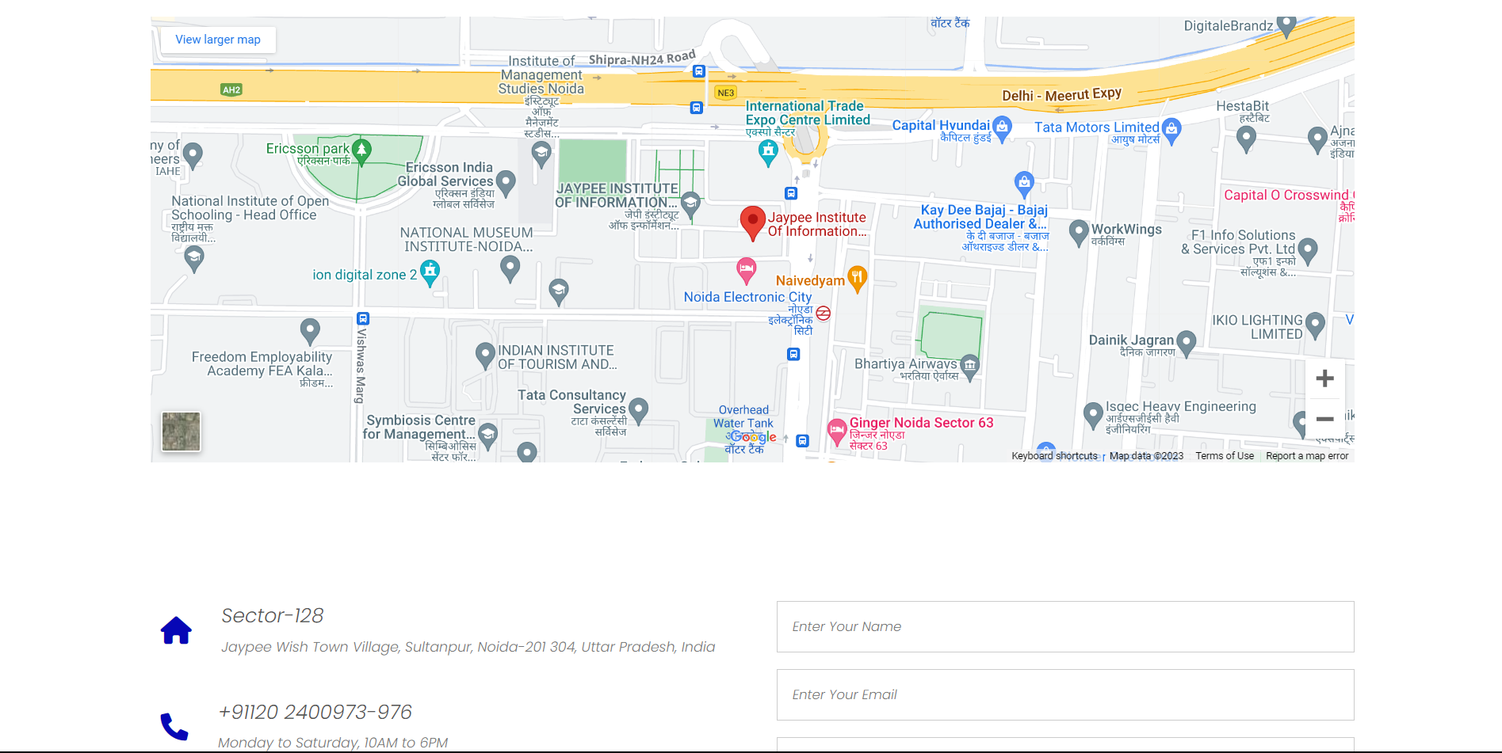

Slide 32
